Slide 1
Support Vector Machine
Classification , Regression and Outliers detection

Slide 2
Introduction
A Support Vector Machine (SVM) is a discriminative classifier which intakes training data (supervised learning), the algorithm outputs an optimal hyperplane which categorizes new examples.
SVM

Slide 3
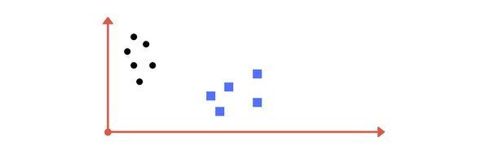
What could be drawn to classify the black dots from blue squares?

Slide 4
Linearly separable data
A line drawn between these data points classify the black dots and blue squares.

Slide 5
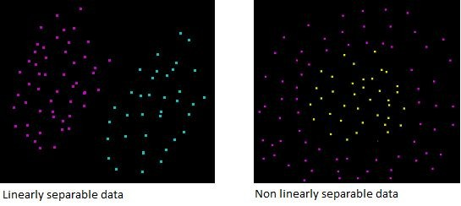
Linear vs Nonlinear separable data

Slide 6
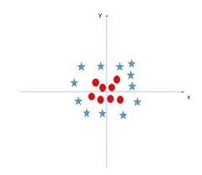
NonLinearly separable data
What could be drawn to classify these data points ( red dots from blue stars )?

Slide 7
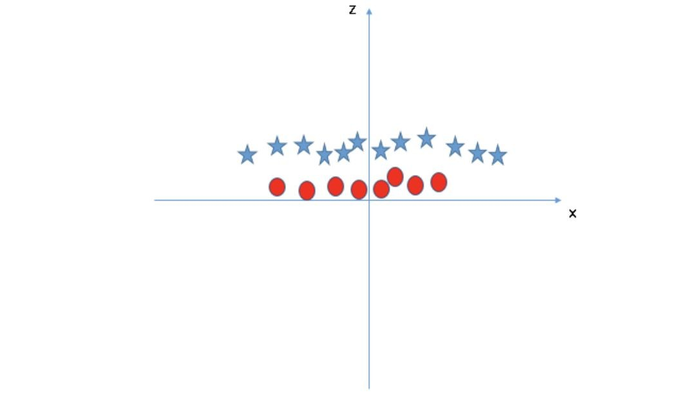
NonLinearly separable data
Here the hyperplane is a 2d plane drawn parallel to x-axis that is the separator.

Slide 8
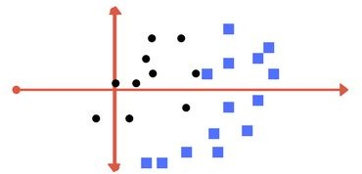
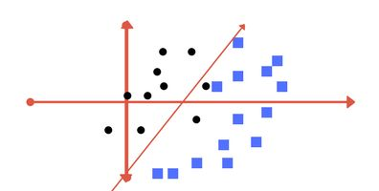
Non Linear data ( type 2 )
Raw Data
Line as Hyperplane

Slide 9
For the previous data the line , if used as a
Hyperplane
Two black dots also fall in category of blue squares
Data separation is not perfect
It tolerates some outliers in the classification

Slide 10
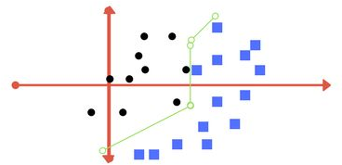
This type of separator best provides the classification.
But
It is quite difficult to train a model like this .
This is termed as Regularisation parameter.

Slide 11
1. Kernel
Tuning Parameters
SVM
Regularization
Gamma
Margin

Slide 12
Margin
Margin is the perpendicular distance between the closest data points and the Hyperplane ( on both sides )
The best optimised line ( hyperplane ) with maximum margin is termed as Margin Maximal Hyperplane.
The closest points where the margin distance is calculated are considered as the support vectors.

Slide 13
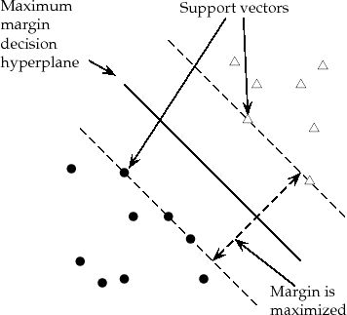

Slide 14
Regularization
Also the ‘ C ‘ parameter in Python’s SkLearn Library
Optimises SVM classifier to avoid misclassifying the data.
C → large
C → small
Margin of hyperplane → small Margin of hyperplane → large
misclassification(possible)
C ---> large , chance of overfit
C ---> small , chance of underfitting

Slide 15
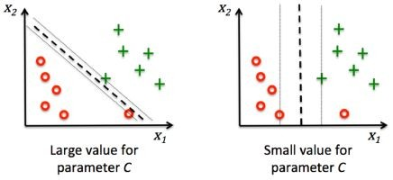
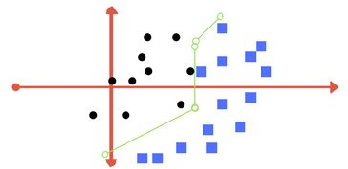
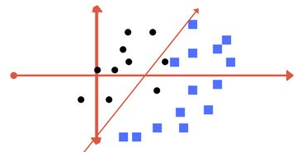

Slide 16
Gamma
Defines how far influences the calculation of of plausible line of separation.
Low gamma -----> points far from plausible line are considered for calculation
High gamma -----> points close to plausible line are considered for calculation

Slide 17
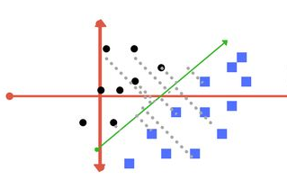
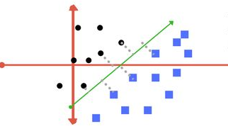
High Gamma Value
Low Gamma Value

Slide 18
Kernels
Mathematical functions for transforming data
using some linear algebra
Different SVM algorithms use different types of kernel functions

Slide 19
Various kernels available
Linear kernel
Non - linear kernel
Radial basis function ( RBF )
Sigmoid
Polynomial
Exponential

Slide 20
Example :
K(x, y) =
<f(x), f(y)>
Kernel function
dot product of n- dimensional inputs

Slide 21
Mathematical representation
x = (x1, x2, x3); y = (y1, y2, y3)
f(x) = (x1x1, x1x2, x1x3, x2x1, x2x2, x2x3, x3x1, x3x2, x3x3) f(y) = (y1y1, y1y2, y1y3, y2y1, y2y2, y2y3, y3y1, y3y2, y3y3)
K(x, y ) = (<x, y>)²
x = (1, 2, 3)
y = (4, 5, 6)
f(x) = (1, 2, 3, 2, 4, 6, 3, 6, 9)
f(y) = (16, 20, 24, 20, 25, 30, 24, 30, 36)
<f(x), f(y)> = 16 + 40 + 72 + 40 + 100+ 180 + 72 + 180 + 324 = 1024
K(x, y ) = (4 + 10 + 18)² = 1024 ----> Kernel function

Slide 22
Pros :
It works really well with clear margin of separation
It is effective in high dimensional spaces.
It is effective in cases where number of dimensions is greater than the number of samples.
It uses a subset of training points in the decision function
(called support vectors), so it is also memory efficient.

Slide 23
Cons :
It doesn’t perform well, when we have large data set because the required training time is higher
It also doesn’t perform very well, when the data set has more
noise i.e. target classes are overlapping
SVM doesn’t directly provide probability estimates, these are calculated using an expensive five-fold cross-validation. It is related SVC method of Python scikit-learn library.

Slide 24
Applications :
Face detection
Text and hypertext categorization
Classification of images
Bioinformatics
Handwriting recognition
Protein fold and remote homology detection
Generalized predictive control(GPC)

Slide 25
Let’s code now
Data used : Iris from Sklearn
Plots : Matplotlib
Kernels : Linear and rbf File : svm_final.py
Link to code : Click here for code

Slide 26

Thank You

